Slide 1
Digital Portfolio
STUDENT NAME: MAHALAKSHMI
REGISTER NO AND NMID: 2428B0009 AND asbruap2428b0009
DEPARTMENT: BSC CS WITH DA
COLLEGE:PPG COLLEGE OF ARTS AND SCIENCE,BHARATHIYAR UNIVERSITY.

Slide 2
PROJECT TITLE
SIMPLE PORTFOLIO

Slide 3


AGENDA
Problem Statement
Project Overview
End Users
Tools and Technologies
Portfolio design and Layout
Features and Functionality
Results and Screenshots
Conclusion
Github Link
3/21/2024 Annual Review

Slide 4

PROBLEM STATEMENT
In today’s digital landscape, having an online presence is crucial for personal branding and career advancement. However, many individuals lack a simple, clean, and professional way to showcase their skills, projects, and contact information. This project aims to solve that problem by creating a lightweight, responsive portfolio website that effectively presents an individual's professional profile.

Slide 5

PROJECT OVERVIEW
This project is a personal portfolio website built using HTML, CSS, and JavaScript. It includes an "About Me" section, showcases multiple projects, provides a contact form, and offers smooth navigation. It is designed to be responsive and user-friendly on both desktop and mobile devices.

Slide 6

WHO ARE THE END USERS?
The primary end users of this portfolio are:
Recruiters and hiring managers
Potential clients
Fellow developers and collaborators
Personal network (friends, mentors, etc.)

Slide 7

TOOLS AND TECHNIQUES
HTML5 – Structure and content layout
CSS3 – Styling and responsive design
JavaScript – Interactivity (e.g., form submission feedback)
Visual Studio Code – Code editor
Git & GitHub – Version control and hosting

Slide 8
POTFOLIO DESIGN AND LAYOUT
The design follows a minimalistic and professional aesthetic:
Header: Contains the site title and navigation links
About Section: Brief introduction with background info
Projects Section: Highlights 2 sample projects with titles and descriptions
Contact Section: Simple form to collect name, email, and message
Footer: Copyright notice
The layout is responsive and adapts well to various screen sizes.
8

Slide 9
FEATURES AND FUNCTIONALITY
Fully responsive layout
Smooth navigation with internal links
Interactive contact form with JavaScript-based confirmation message
Modular code structure (separate HTML, CSS, JS files)
Clean, readable UI design

Slide 10
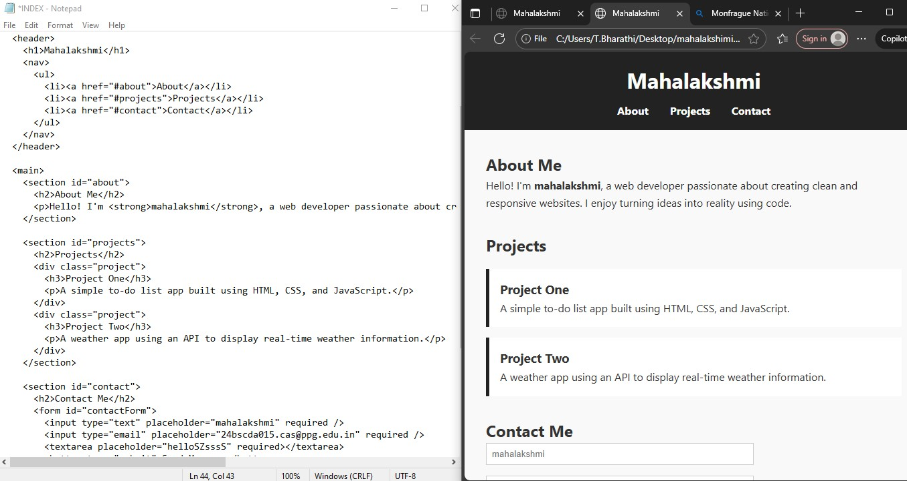

RESULTS AND SCREENSHOTS
3/21/2024 Annual Review
10

Slide 11
CONCLUSION
This portfolio website provides a professional and organized way to present an individual’s work and skills. It serves as a strong foundation for further development, such as adding animations, blogs, downloadable resumes, or API-based features.
11

